Slide 1
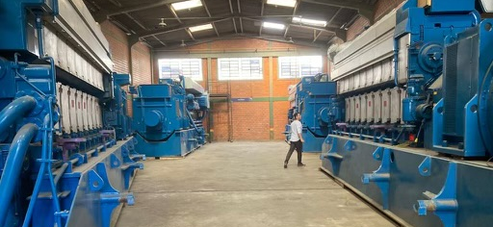
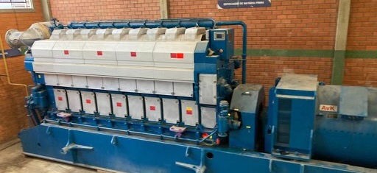
Turnkey 14.8MW Wartsila Package

Slide 2
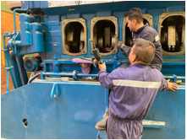
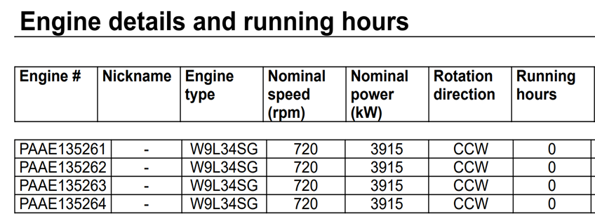
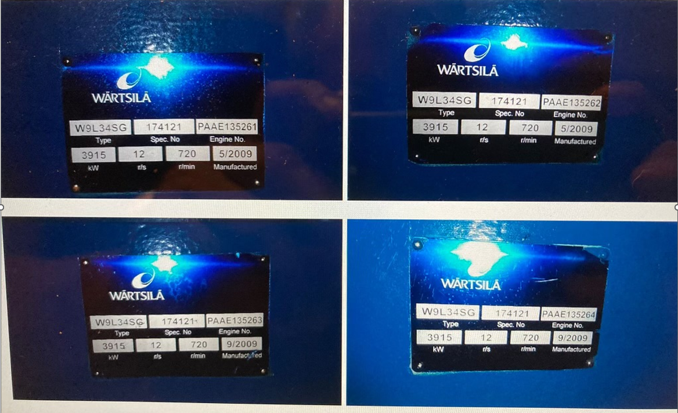
Gen Sets
4x 3.7MW Wartsila Nat Gas Gen Sets
Manufactured 2009
0 hr, unused/surplus
6600v, 60Hz
Available For Immediate Inspection

Slide 3
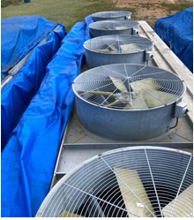
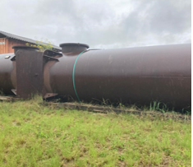
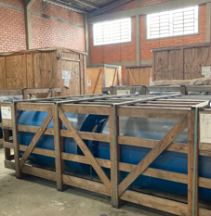
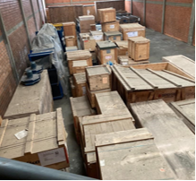
Ancillary Equipment
Cooling System
Air Starting System
Controls
Exhaust
Switchgear
Complete Packing List Available

Slide 4
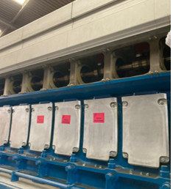
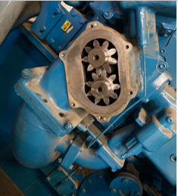
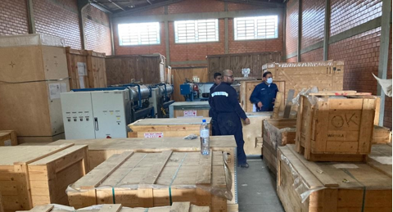
Additional Information
Complete Wartsila Inspection Done 11/2022
Complete Supply of Spare Sparts (Packing List Available)
Current Equipment Location: South America
Price: 9 075 000$ Million FOB Port of Houston

